Slide 1

Recent News: Impact and Reflections
Welcome to this presentation that explores some recent events of great social impact and their implications. We will analyze news, mourning and political cases, reflecting on their consequences and the role of the media and individuals.

Slide 2

The Puff Daddy Case: Abuse Allegations
The Accusation
The Number of Victims.
Sean "Puff Daddy" Combs has recently been accused of physical and sexual violence, drug trafficking, and sexual exploitation. The allegations include systematic abuse against multiple victims.
The main victims of "Puff Daddy" include Cassie Ventura, Combs' ex-girlfriend, Derrick Lee Cardello-Smith, and Rodney "Lil Rod" Jones, a former collaborator. However, there are many others.
Social Impact.
The allegations have shaken the American music industry, as Puff Daddy is a prominent figure in the sector. The case sheds light on the dark side of power in entertainment and could have serious consequences for the hip-hop scene.

Slide 3

Mourning for Maggie Smith: An Icon of Cinema
1
First years
Maggie Smith, born in 1934, began her stage career in the 1950s.
2
Global Success
He achieved international fame with memorable roles in films such as "The Prime of Miss Jean Brodie" and "California Suite".
3
Recognition
Winner of two Oscars, Maggie Smith was an icon of British cinema, appreciated for her elegance and talent.

Slide 4
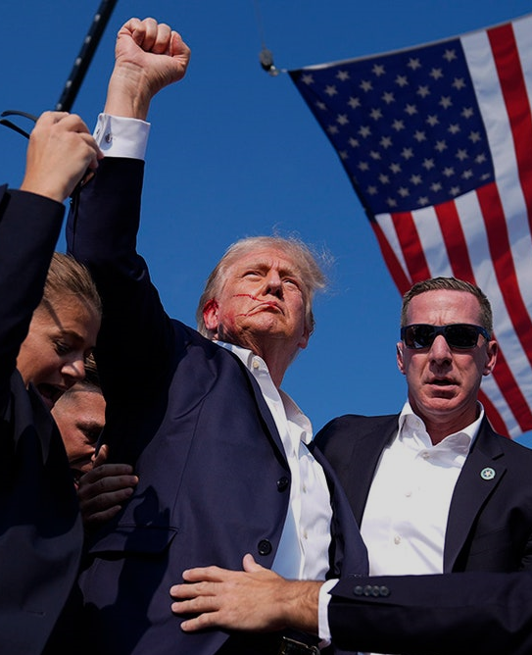
Presidential elections 2024: voters and shooters
This 6th of November
The Biden Administration vs Donald J Trump

Slide 5
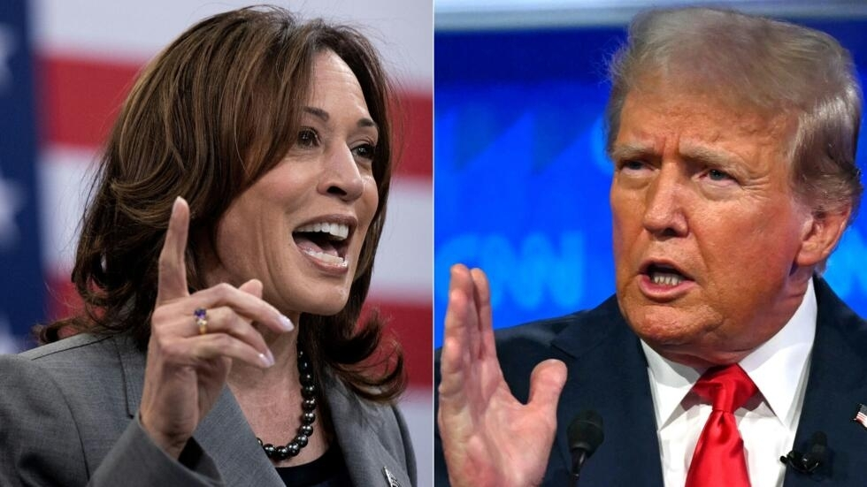
The candidates
Kamala D Harris
Donald J Trump
Left wing vice-president
The Biden administration
Right wing ex-president
The Trump organization

Slide 6

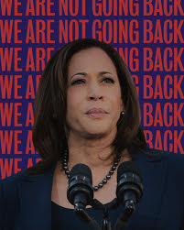
The controversy: Kamala Harris
Fracking and the youth
Fracking:
"the injection of a fluid at high pressure into an underground rock formation to open fissures and allow trapped gas or crude oil to flow through a pipe to a wellhead at the surface".

Slide 7

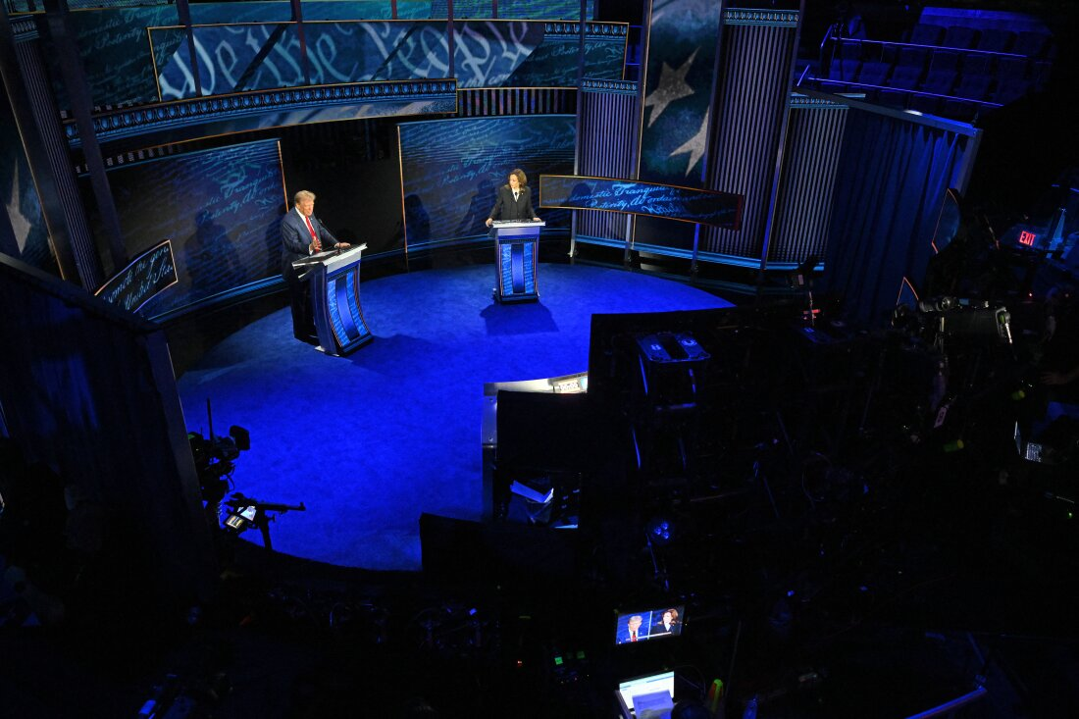
The controversy: Donald Trump
Discrimination and immigrants
As said in the presidential debate

Slide 8

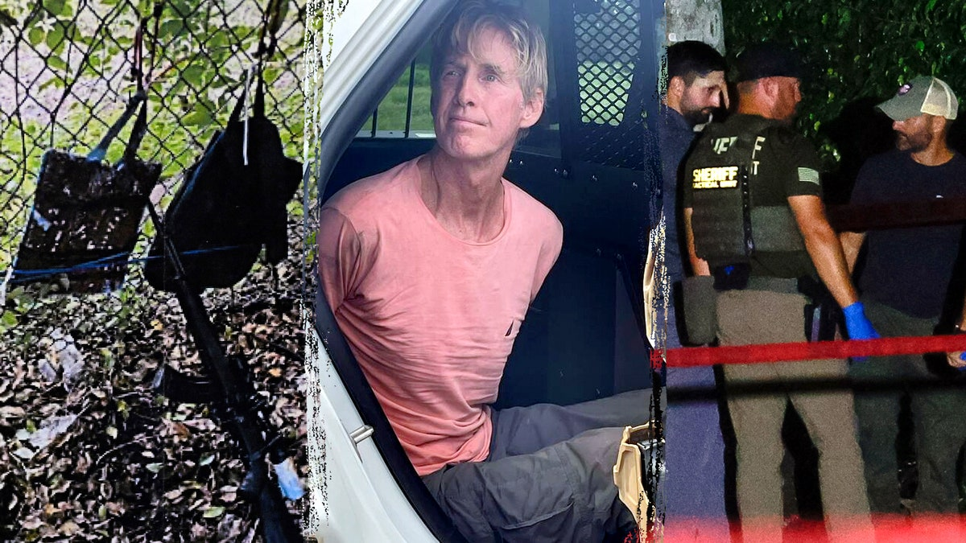
The controversy: the shooters
July 7th
Thomas Matthew Crooks
September 15th
Ryan Wesley Routh

Slide 9
Impact of News on Society
Public Opinion
Social Behaviors
Decision-making processes
News shapes public opinion, influencing people's perceptions and beliefs.
The media can promote positive behaviors, such as solidarity, or negative ones, such as discrimination.
News influences individual and collective decisions, ranging from the choice of a product to the election of a leader.

Slide 10
Reflections on Socials Consequences
Uncertainty
1
These events raise questions about the future and security
Public Debate
2
The public debate intensifies, bringing sensitive issues to light.
Social Change
3
These events can push society towards change, promoting awareness and justice

Slide 11




Importance of Responsibility and Ethics in the Media
Truthfulness
Objectivity
Transparency
The media have a duty to provide accurate and verified information.
The presentation of different points of view is essential for complete information.
Clarity about sources and working methods is essential for credibility.

Slide 12




Conclusions ad Ideas for the future
Stayed Informed
Follow the news and stay updated on important events.
Promote Dialogue
Engage in open and respectful conversations about the role of the media.
Support the change
Act to promote justice and social responsibility.

